Slide 1

“GET ATTENDENCE” For Taking Attendance of students

Slide 2

Get Attendence
“GET Attendance” is a Software developed for daily student attendance in colleges and institutes. It facilitates to access the attendance information of a particular student in a particular Semester. The information is sorted by the operators, which will be provided by the teacher for a particular Branch. This system will also help in evaluating attendance eligibility criteria of a student.

Slide 3

Purpose
The purpose of developing “GET Attendance” is to computerized the tradition way of taking attendance.

Slide 4

FEATURE AVAILABLE
Take attendance and keep them branch-wise and semester-wise .
Add New student.
View each student’s attendance separately.
Edit Student/Attendance late.
Simple and Material designed interface

Slide 5
Problem with Existing Attendance System
Not User Friendly: The existing system is not user friendly because the retrieval of data is very slow and data is not maintained efficiently
Manual control: All calculations to generate report is done manually so there is greater chance of errors.

Slide 6

Lots of paperwork:
Existing system requires lot of paper work. Loss of even a single register/record led to difficult situation because all the papers are needed to generate the reports.

Slide 7

Time consuming
Every work is done manually so we cannot generate report in the middle of the session or as per the requirement because it is very time consuming.

Slide 8
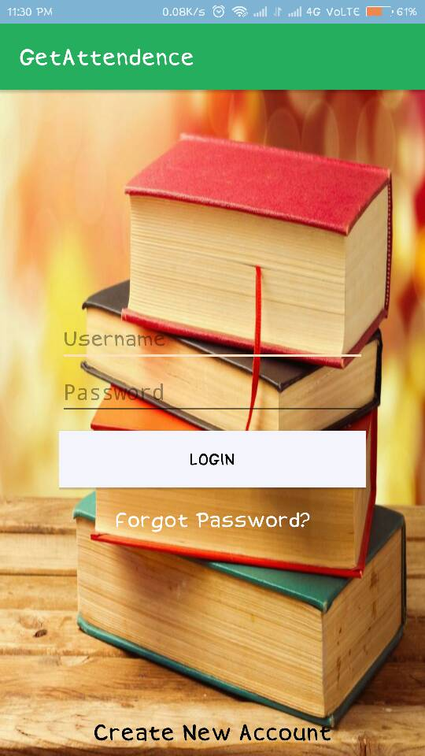
LogIn Activity
LogIn
Register New user
Resest Your Password

Slide 9
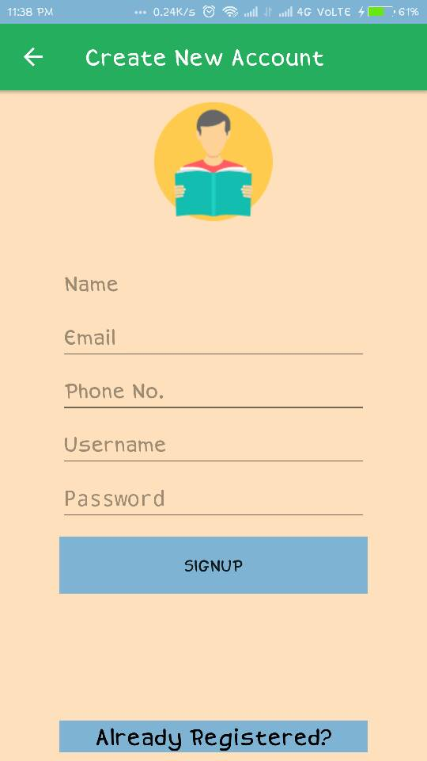
Sign Up
Get SignUp
Use Email For SignUp

Slide 10
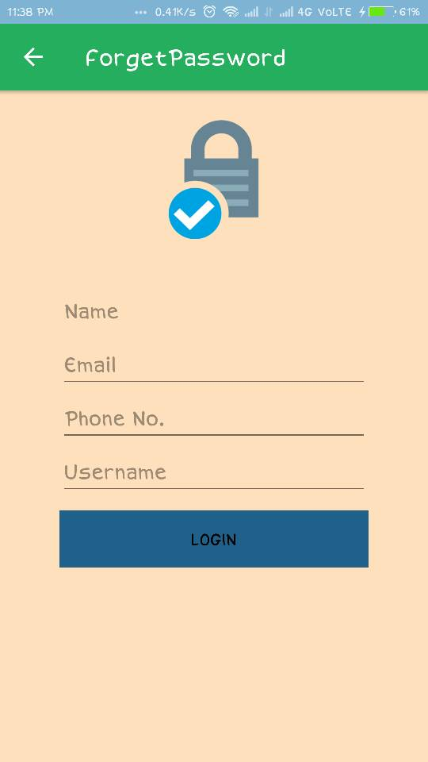
Forget Password
Enter your Details
Reset Your Password

Slide 11
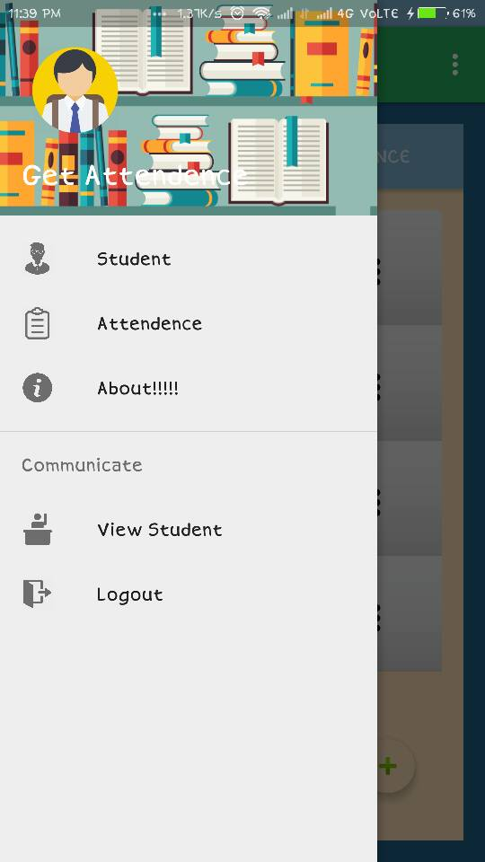
Navigation Bar
It has:-
Student Module
Attendance Module
View Student
About
Logout

Slide 12
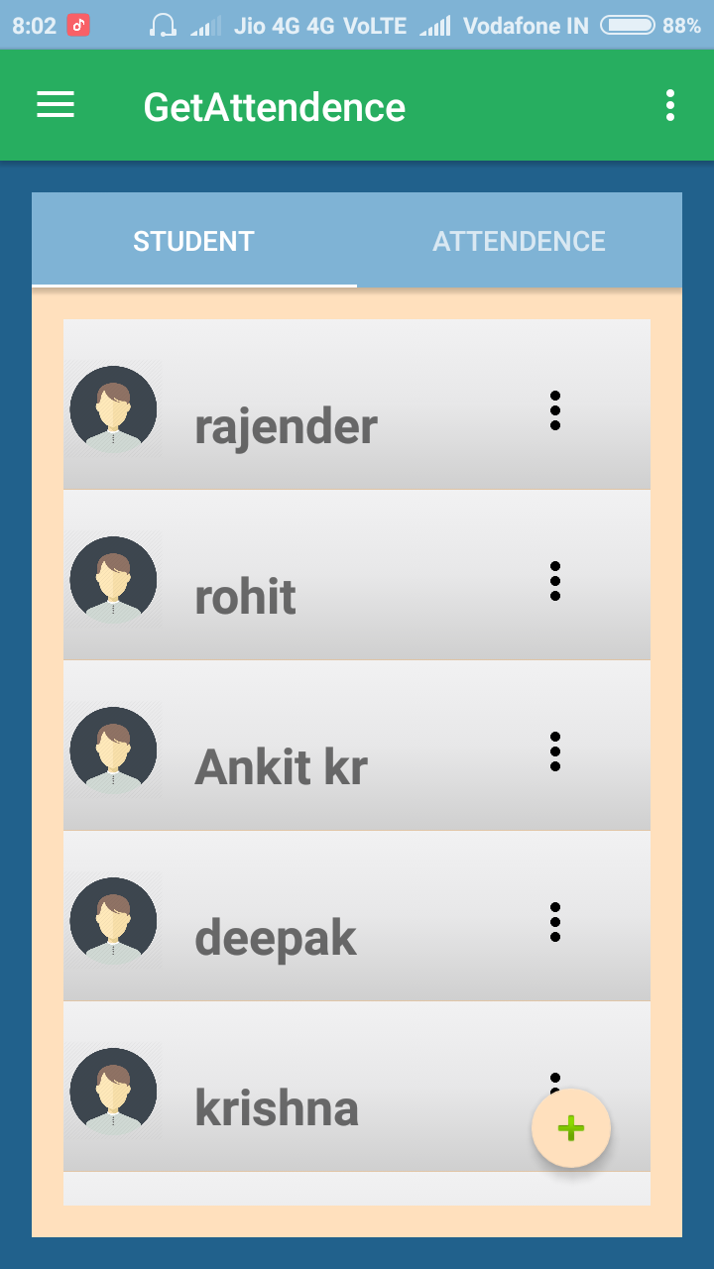
Main Activity
It has two Module :-
1.Student Module
2.Attendence Module

Slide 13
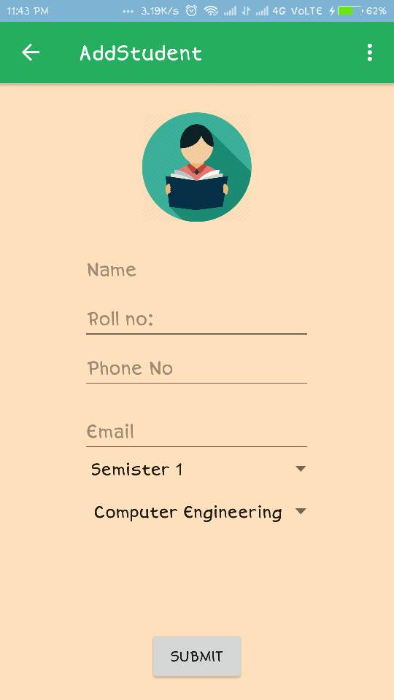
Add Student
Add Student Details.
Select Semester.
Select Branch.

Slide 14
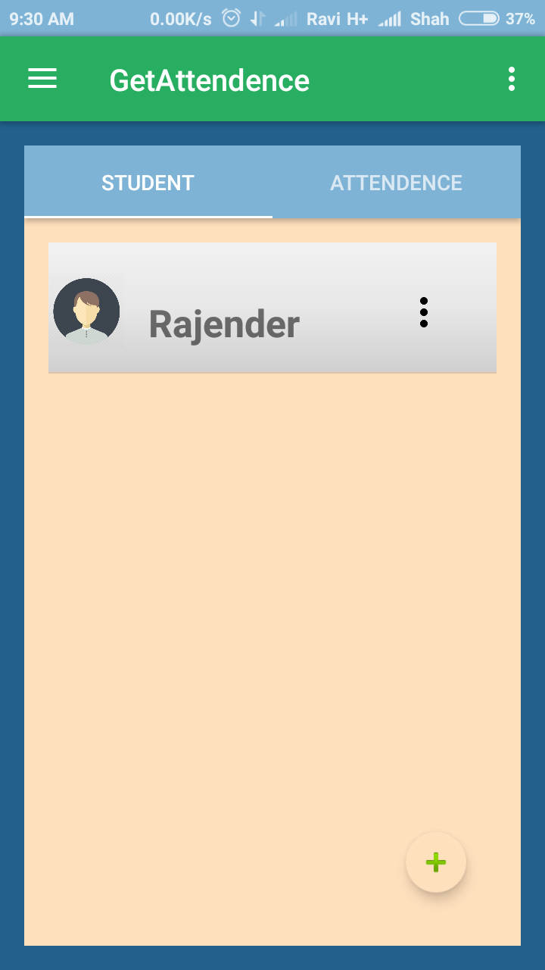
After Adding a Student
The Data is Stored in database.
It Display As shown Here

Slide 15
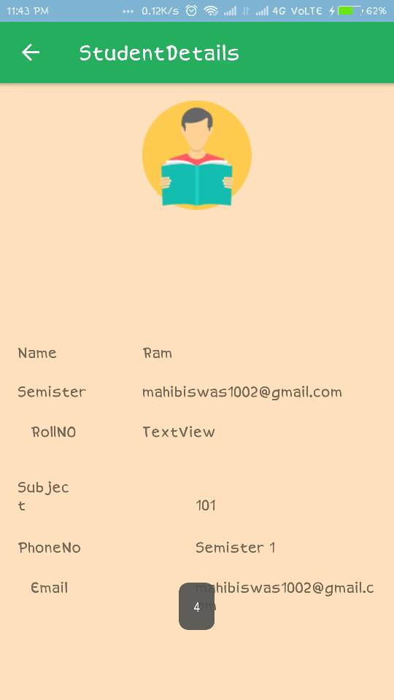
Student Details
You can also click on them to
show Student Details

Slide 16
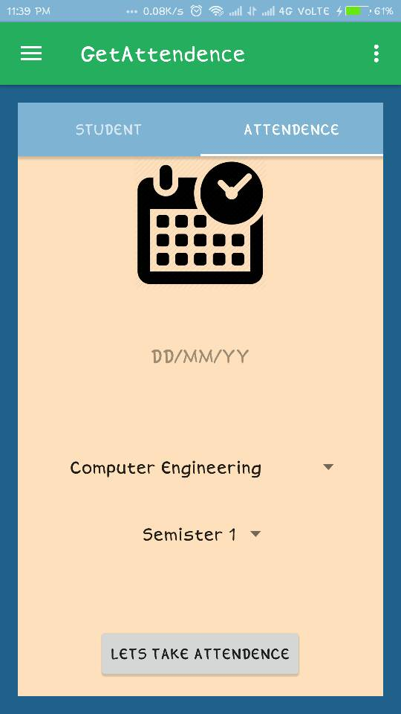
Attendence Activity
Click On calendar to select Date
Select Branch
Select semester
Select student
Mark student attendance

Slide 17
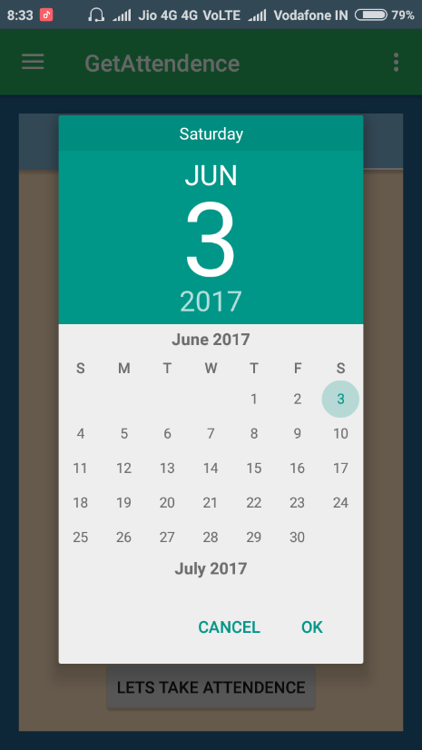
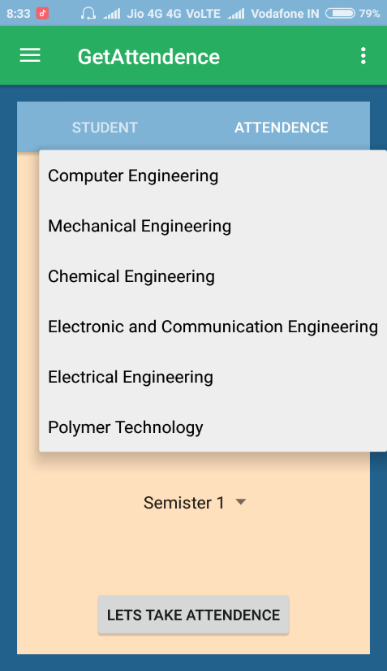
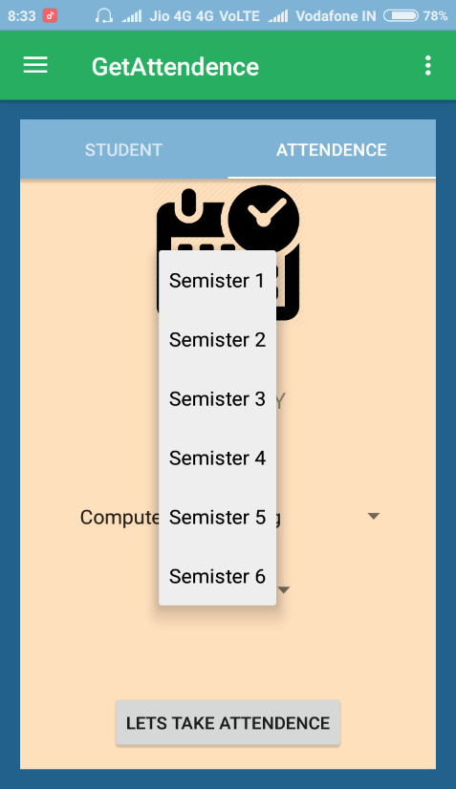
Attendance Activity
1.Select Date 2. Select Branch 3.Select Semester

Slide 18
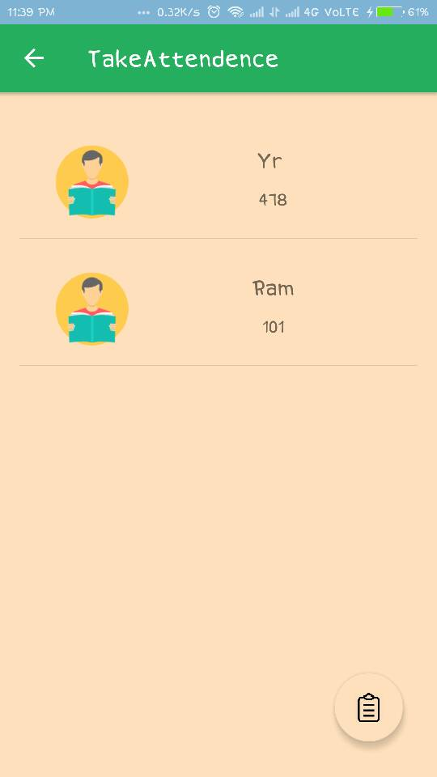
Take Attendence
Click On Student To Take
Attendence.

Slide 19
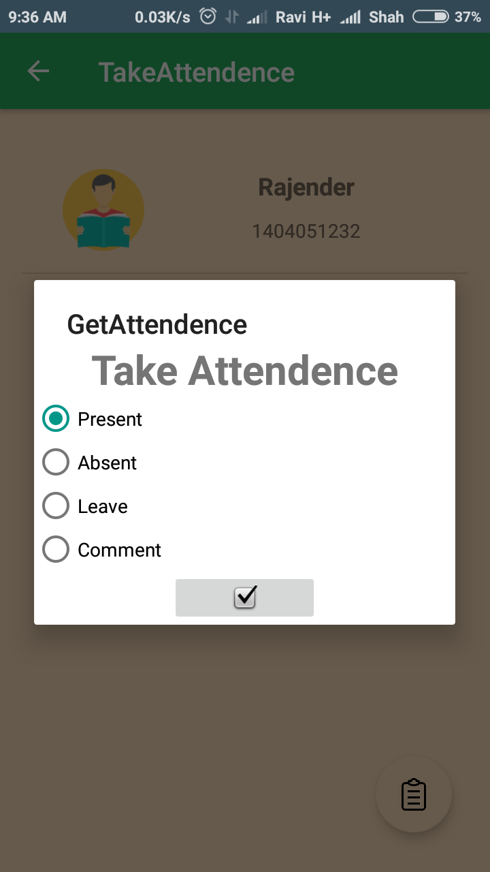
Mark Attendance
Mark Attendance
1.Present
2.Absent
3.Leave
4.Comment(Any other reason )

Slide 20
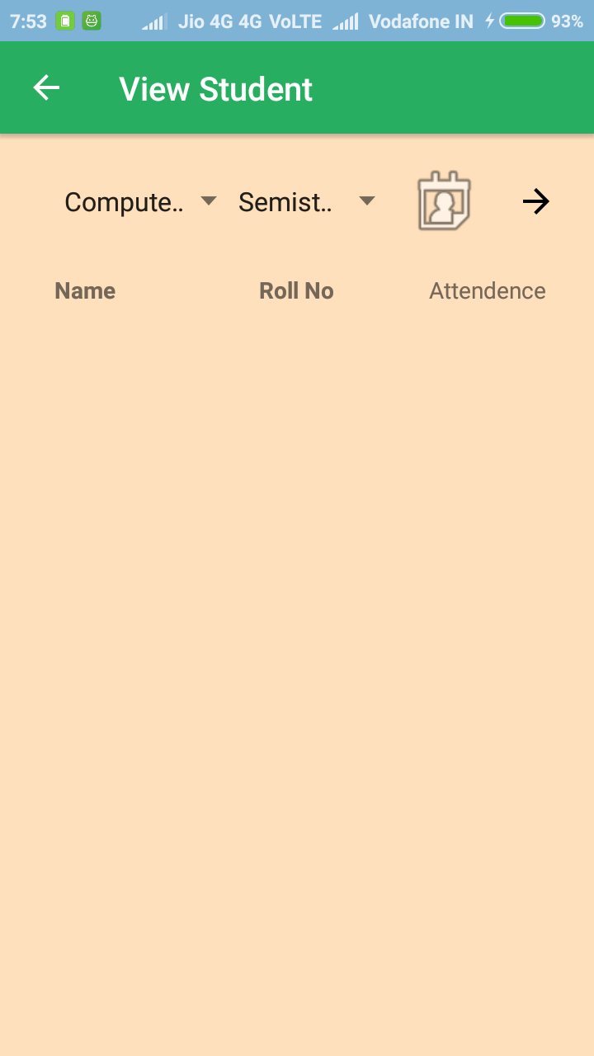
View Student
For View Student
Select Branch
Select Semester
Select Date

Slide 21
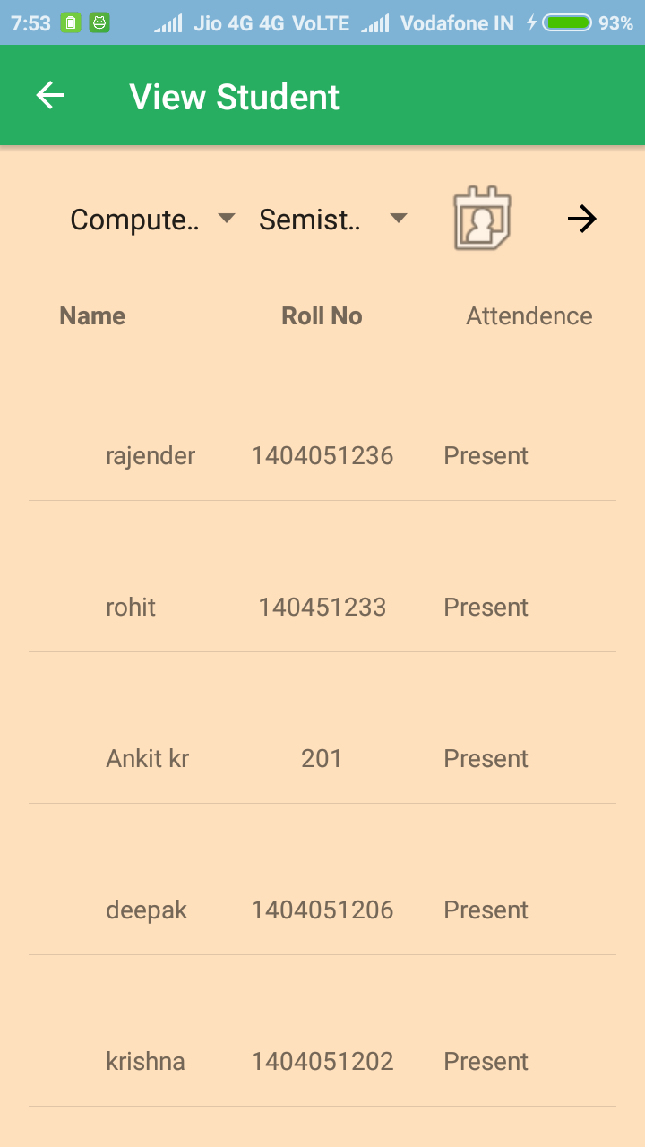
View Student
All Student Listed By there
Name
Roll Number
Attendence(Showing wheather
student is present or not)

Slide 22

CHAREACTERSTIC OF THE PROPOSED ATTENDANCE SYSTEM
User Friendly:-The proposed system is user friendly because the retrieval and storing of data is fast and data is maintained efficiently. Moreover the graphical user interface is provided in the proposed system, which provides user to deal with the system very easily.

Slide 23
Reports are easily generated
reports can be easily generated in the proposed system so user can generate the report as per the requirement (monthly) or in the middle of the session. User can give the notice to the students so he/she become regular.

Slide 24

Very less paper work
The proposed system requires very less paper work. All the data is feted into the computer immediately and reports can be generated through computers. Moreover work become very easy because there is no need to keep data on papers.

Slide 25

Digital operator control
since all work is digitalized so will be there so no chance of errors. Moreover storing and retrieving of information is easy. So work can be done speedily and in time

Slide 26
Advantage of this application
1. Reduce paperwork and save time and money with mobile and cloud-based attendance management system
2. Eliminate duplicate data entry and errors in time and attendance entries
3. Improve visibility to track and manage student attendance & absenteeism across multiple campuses

Slide 27
4. Real-time status tracking of leave requests.
5. Automatic calculation of leave and reward points accrued.
6. Easy attendance recording using RFID & Biometric based attendance system.
7. Track the attendance of teachers and staff, assign work and manage allocation.

Slide 28
8. Keep the parents informed about the student’s performance via Email & SMS alerts.
9. Auto-generate various types of reports of class or student attendance.
10. Increased security and confidentiality with role-based permissions to users.

Slide 29
INNOVATIONS & USEFULNESS
This project has a large scope as it has following feature which help in making it easy to use:-
Management of Student Data
To save environment by using paper free work
It increase the accuracy and efficiency of the placement procedure

Slide 30
SIGNIFICANCE OF PROJECT
The significance of the project is to provide the following benefits:-
The significance of project is to digitize the attendance system
There no need of Register no more
Teacher can use it easily
Teacher can also know about the fee of the student

Slide 31
MARKET POTENTIAL & COMPETIVE ADVANTAGE
There is high potential of this application.
There are very need to set digital software of attendance
There is also less competition in this type of application

Slide 32
Conclusion
This project and application is based on real scenario and its help to teacher to take attendance of students easily without facing any problem through this application ,And this application an store basic information about students.

Slide 33
THANKYOU….

